Slide 1

VOICE GENDER RECOGNITON
Machine learning

Slide 2

ABOUT
Gender Recognition By Voice Is A Technique In Which You Can Determine The Gender Category Of A Speaker By Processing Speech Signals. In This Tutorial, We Will Be Trying To Classify Gender By Voice Using The Tensorflow Framework In Python.
Gender Recognition Can Be Helpful In Many Fields, Including Automatic Speech Recognition, In Which It Can Help Improve The Performance Of These Systems. We Can Also Use It In Categorizing Calls By Gender, Or You Can Add It As A Feature To A Virtual Assistant That Can Distinguish The Talker's Gender
​
​

Slide 3

MOTIVATION
To design an automatic speech recognition system that gives best recognition results for both male and female speakers

Slide 4
EASY TO READ
TENSORFLOW
DNN
TensorFlow is a free and open-source software library for machine learning and artificial intelligence
A deep neural network (DNN) is an artificial neural network (ANN) with multiple layers between the input and output layers
SKLEARN
LIBROSA
Scikit-learn is a free software machine learning library for the Python programming language
Librosa is a python package for music and audio analysis. It provides the building blocks necessary to create music information retrieval systems.

Slide 5




CODE
CODE
.SAV
AUDIO FILE
MODEL
​AGE AND GENDER RECOGNITION.IPYNB
FILE
RECORDED AUDIO
MODEL (BUILT)

Slide 6
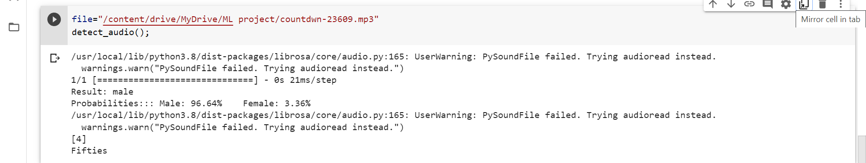
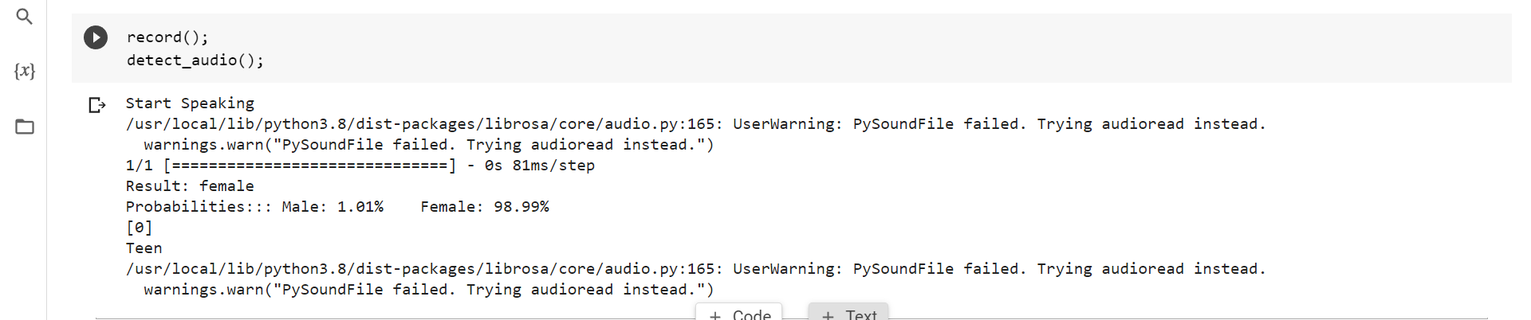
OUTPUT

Slide 7
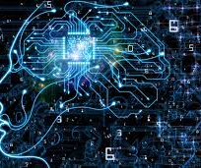
Thank you
MEGHANA KAVANA
4NM20AI025 4NM20AI020

